Slide 1

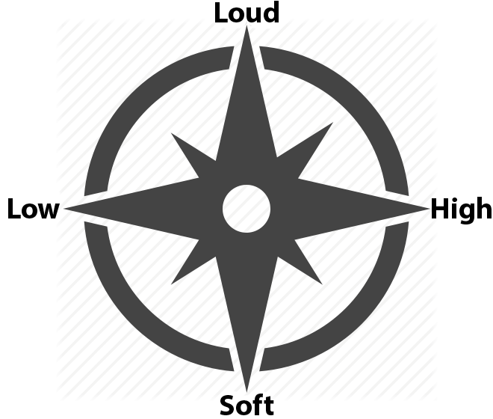

Faculty of Natural Sciences
The Department of Computer Science
Voice Stick
Sagie Levy, Mikey Shechter
Advisor: Prof. Andrei Sharf
Analyzes user’s voice and represents it as a controller input, similar to a Joystick.
Voice is interpreted on two Axes.
The Y axis represents the volume of the user’s voice ranging from very soft to very loud.
The X axis represents the pitch of the user’s voice ranging from low to high.

